Slide 1
WORLD OF DRONE
How Quadcopters Work

Slide 2
How Quadcopters Work?
In order to make a drone fly, specifically a quadcopter, it need to be composed by four main controls: roll, pitch, yaw, throttle.

Slide 3
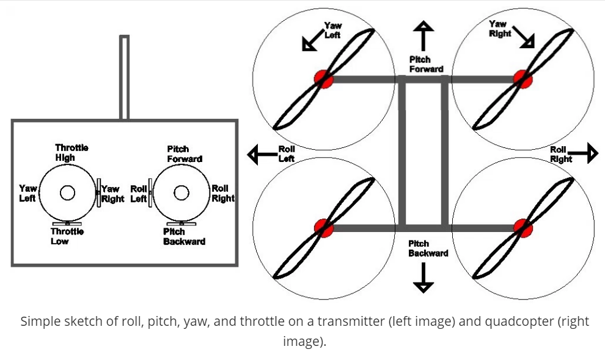
How Quadcopters Work?

Slide 4
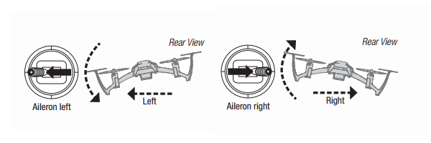
Roll?
It moves the quadcopter to left or right. It’s done by pushing the right stick on your transmitter to the left or to the right.
It’s called “roll” because it literally rolls the quadcopter.

Slide 5
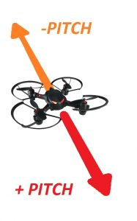
Pitch?
Pitch is the movement of the quadcopter either forward and backward. This is done by pushing the right stick on the transmitter forwards or backwards.

Slide 6
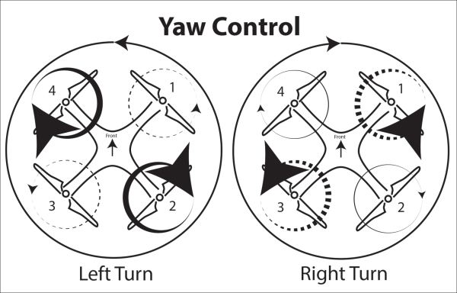
Yaw?
Yaw is the deviation/rotating the head of the quadcopter either to right or left. In other words, it rotates the quadcopter clockwise or counterclockwise.

Slide 7
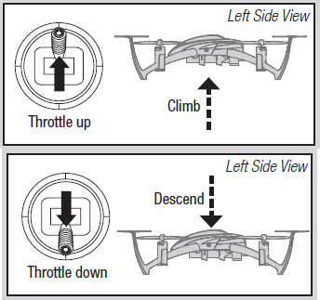
Throttle?
Throttle gives the propellers on the quadcopter enough power to get airborne an allows the drone move to up and down vertically.

Slide 8
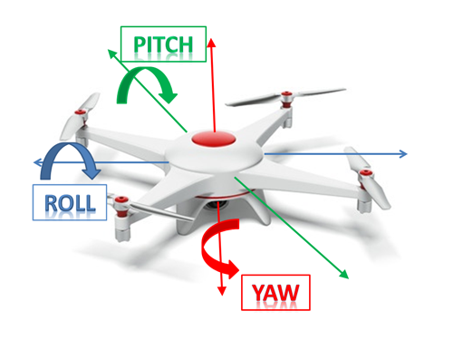
Roll vs Pitch vs Yaw

Slide 9
?
WELL DONE!
Now you can move on to the next topic...
Drone Applications!

